Slide 1
Study Room Booker Project Proposal
Jocelyn Baduria
Alisonbrooke Reikher
Adam Woods
Zackery Hutchinson
CS31 – Java Programming

Slide 2
Overview
Project Description
Data Model
Architecture
Project Plan

Slide 3
Project Description
Study Room Booker is a program for students or teachers to reserve study rooms. It is intended for use in any institution that has rooms available for student use.
Rooms can be reserved up to 2 days ahead
Rooms can be reserved in 2-hour blocks, in increments of 30 minutes
If a room is unavailable, the user may join a waiting list for that room
Rooms can accommodate 1-6 people

Slide 4
Data Model
Room
Reservation
User
String roomNumber
String roomName
Int maxPeople
Room room
User user
Date startDateTime
Date endDateTime
String userID
String name
1
0..*
0..1
1
Teacher
Student
String department
String studentId

Slide 5
Architecture
Room Booker Menu
Manage Users
Manage Rooms
Manage Reservations
Display Schedule
Database (H2)

Slide 6
Architecture
Manage Users
Add a User
Edit a User
Delete a User

Slide 7
Architecture
Manage Rooms
Add a Room
Edit a Room
Delete a Room

Slide 8
Architecture
Manage Reservations
Add a Reservation
Modify a Reservation
Delete a Reservation
Extend a Reservation

Slide 9
Architecture
Display Schedule
Display Today’s Schedule for Room
Display Tomorrow’s Schedule for Room
Display Schedule for Room By Date
Display User’s Reservations
Display Room Schedule

Slide 10
Project Plan
Task | Assign To
Project Overview & Design | Jocelyn, Alison, Adam, Zack
Data model design | Jocelyn
Architecture | Jocelyn, Alison, Adam, Zack
Set up H2 Database | Jocelyn, Adam
Create Github Project | Jocelyn
Create Menu GUI | Zack, Alison
Implement Users | Zack
Implement Rooms | Alison
Implement Reservations | Jocelyn
Implement Schedule Display | Adam

Slide 11
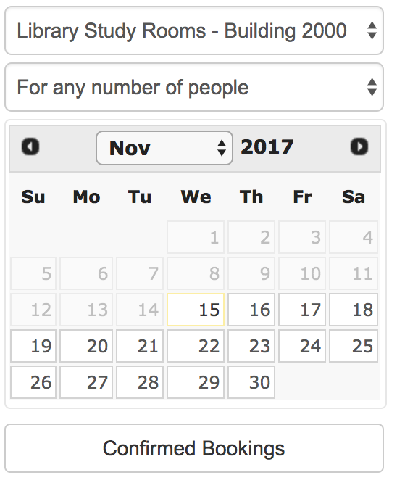
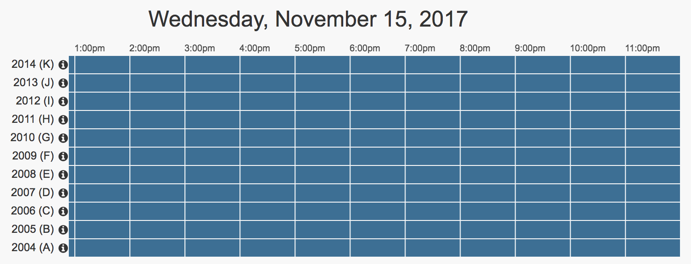
Design with GUI
Room Booker

Slide 12
Room Booker
Room Booker
Manage Users
Manage Rooms

Slide 13
Room Booker
Manage Users
Joe Smith
April May
Lee Wu
Tammy Brown
User ID:
JS001
Name:
Joe Smith
Type:
Student
Student ID:
Joe Smith
Department:
Math
+
-
Edit
Cancel
Save

Slide 14
Room Booker
Manage Rooms
Office 1
Office 2
Conference 1
Conference 2
Study 1
Study 2
Room ID:
Office 1
Name:
Small office with table
Max People:
4
+
-
Edit
Cancel
Save

Slide 15
Room Booker
Confirm Booking
Room:
JS001
From:
Mm/dd/yy hh:mm
To:
Mm/dd/yy hh:mm
User:
John Lee
Number in Party:
4
Cancel
Confirm

